Slide 1
EyeMate for blind & Blind Tracker
CSE 3200
Software Development Project-||
Supervised by
Md.Kowsar Hossain
Assistant Professor
Department of CSE,KUET
Developed by
Sharmin Shobnom Desha Roll: 1107013
Md. Siddiqur Rahman Tanveer Roll: 1107048

Slide 2
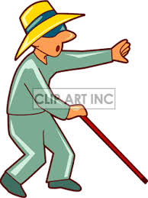
The sufferings of a blind person
Blind person needs a stick to walk
He needs other’s help to walk in the road
Often blind person gets stumbled in the road not knowing the object
Sometimes blind persons are lost
People ignore blind person as they have to depend on other to go outside

Slide 3
Objectives
Helping blind person to walk without a stick
Informing blind person about the location of the obstacle
Telling blind person about the location of the obstacle in Bengali language
Blind person can seek emergency help using the EyeMate app
Tracking the location of the blind person
Rescue blind person immediately from any exceptional condition

Slide 4
System components
Android phone
Maxbotix EZ0 range finders
Arduino Mega 2560 development board
HC-05 Bluetooth module

Slide 5
Development Platforms
Android operating system
Apache server
Php
MySQL
JSON
Arduino development board

Slide 6
Developing Tools
Android Developer Tools v21.0.1-543035
Android Developer Tools v23.0.2.1259578
arduino-1.0.5-r2-windows
xampp-win32-1.7.4-VC6
jdk-7u17-windows-i586

Slide 7
System Overview
Hardware components detect the location of the obstacle and send it to app
EyeMate app tells the blind person about the location of the obstacle
EyeMate app sends the current latitude and longitude to server
Emergency phone number is saved in the EyeMate app

Slide 8
System Overview contd..
Blind person can operate EyeMate app using his/her voice command
Blind person can give voice command by pressing the headset button
Blind person can make emergency phone call applying voice command
Blind tracker app can track the position of the blind person
Blind Tracker app shows the position pointing in Google Map

Slide 9
Project Block Diagram
Database
ls
rs
gs
Arduino Mega
2560
EyeMate App
Blind Tracker App
HC-05
Note: ls = left ultrasonic sensor, rs = right ultrasonic sensor, gs = ground ultrasonic sensor

Slide 10
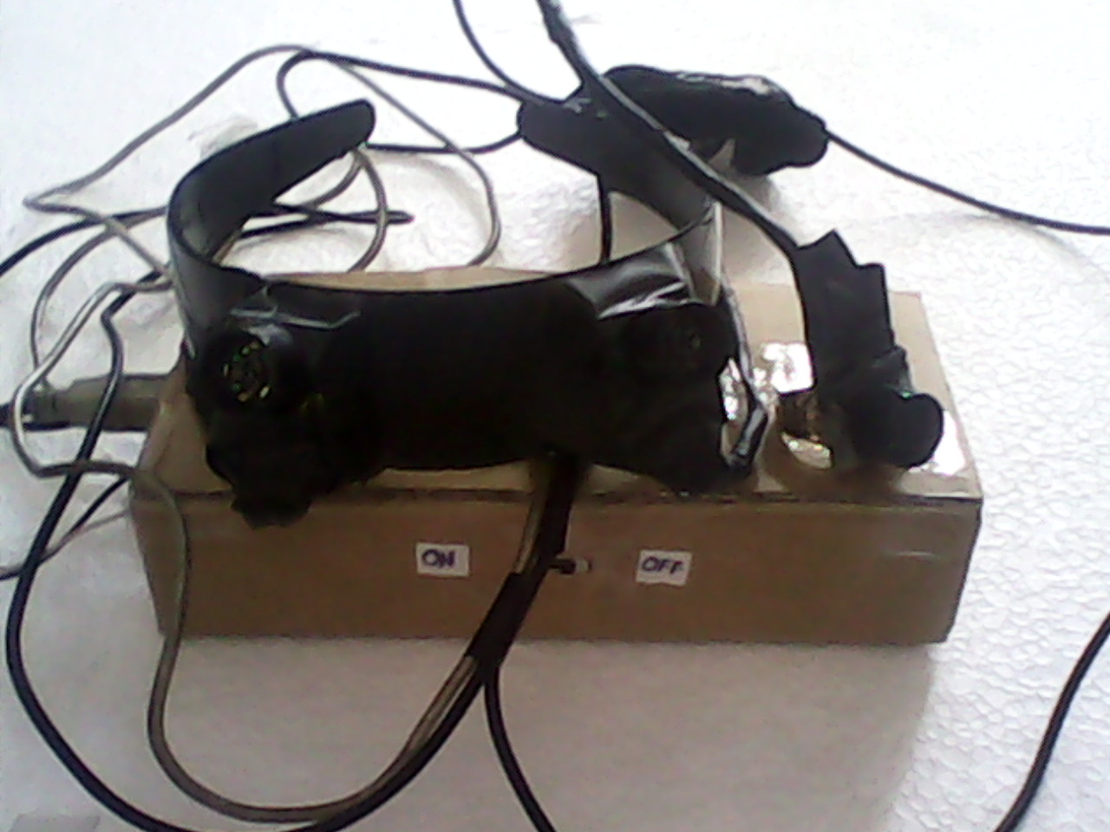
Obstacle detection and sending to phone
Rangefindes detects the several distances of the objects
Rangefinder in hand detects the object in ground
Rangefinders in head band detects the object in front
Arduino Mega filters the distances to get the exact distance
Exact result is sent to Android phone using the HC-05 Bluetooth module

Slide 11
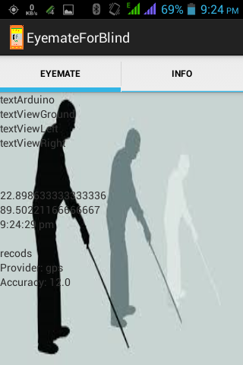
Speaking the location of object in Bengali
EyeMate app is always ready to receive any signal from hardware module
If any obstacle is detected then Android phone speaks the location of the obstacle in Bengali human speech
Ground obstacle is detected in 60 cm distance
In front obstacle is detected in 100 cm range

Slide 12
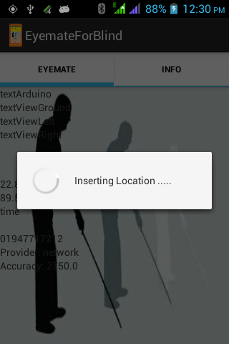
Sending current location to server
Current latitude and longitude are taken dynamically from GPS provider and Network Provider
After 5 minutes location is updated
As soon as the location is updated then it is sent to the server

Slide 13
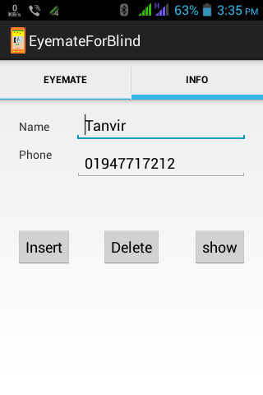
Emergency phone number is saved in app
We can save an emergency number in app so that the blind person can immediately want help by calling that number.

Slide 14
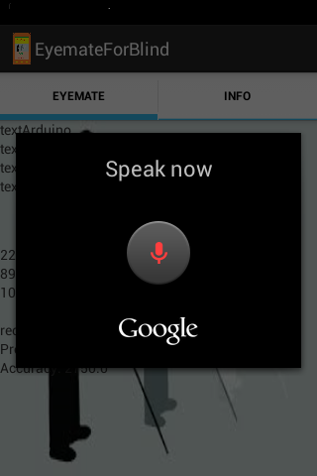
Voice command by pressing Headset Button
Blind person needs not touch the phone to operate the app. Just pressing the head set button it can be done

Slide 15
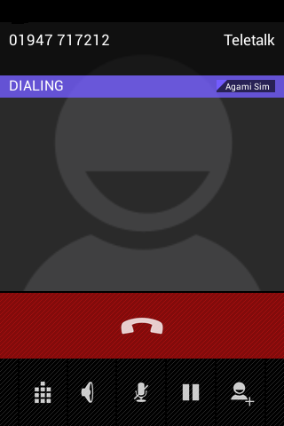
Emergency Phone Calling
Blind person can make emergency phone by voice command in any exceptional condition

Slide 16
Blind Tracker App
After getting the call from the blind person we will go to help the blind person at first getting the position of the blind person by using our Blind Tracker app.

Slide 17
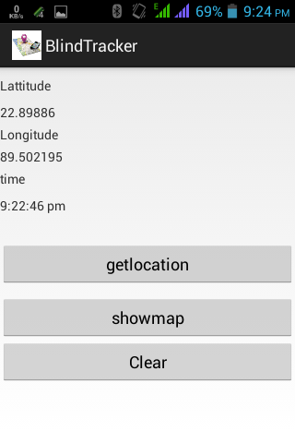
Getting Current position
We can get the current location of the blind person from our server.

Slide 18
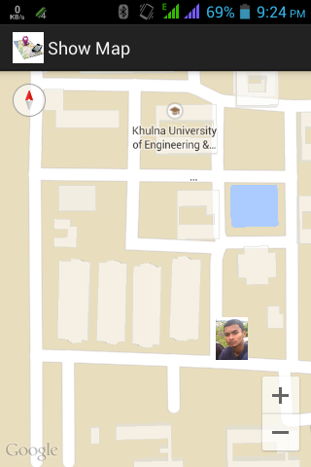
Pointing the location in Google Map
Now we find the location in Google map very easily.

Slide 19
Final outcomes….
Blind person can walk being aware about the obstacle and doesn’t get hurt.
Blind person won’t need other’s help to go outside
Blind person can seek emergency help without touching his / her phone.
No blind person will be lost since we can track them .
In any odd situation we can reach to him/her very easily and early

Slide 20
Limitations
Bluetooth connection often gets disconnected
UltraSonic range finder is interrupted by noise, humidity, temperature
Position getting from Network provider is not always appropriate
Headset button doesn’t work appropriately at all time

Slide 21
Future Plans
Minimize the developing cost of the entire project
Using the vibrator in hardware part so that user may use it without a phone in an exceptional condition
Develop such kind of system for autistic person
Develop digital Image processing for detecting type of the obstacle
Develop the EyeMate app to recognize Bengali voice Command

Slide 22
THANK YOU

